Slide 1
Azure App Configuration

Slide 2
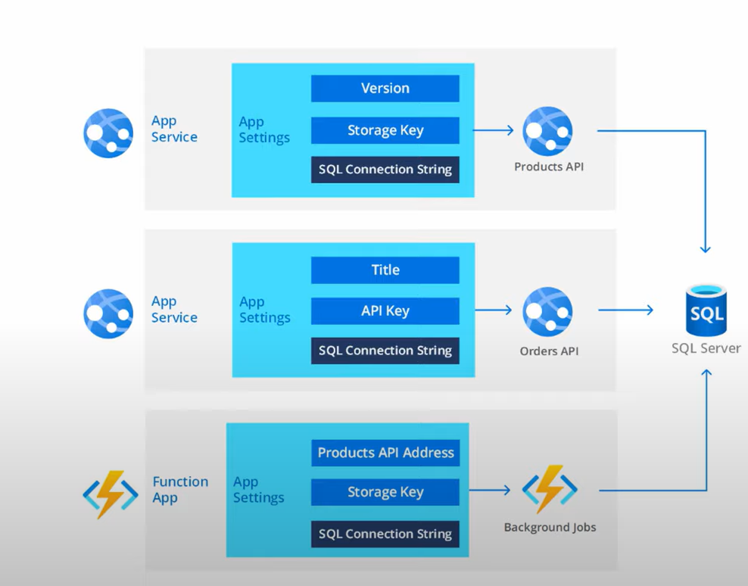
Problem with multiple configurations
In an enterprise application there can be many app services, function apps sharing the common connection string.
If the connection string changes, we need to update all the upstream services which reference it.
Lots of manual effort is needed to maintain and monitor these settings.
Duplicity of same settings in each service.
There is no provision of “hot-reload” of the configuration without restarting the service.

Slide 3
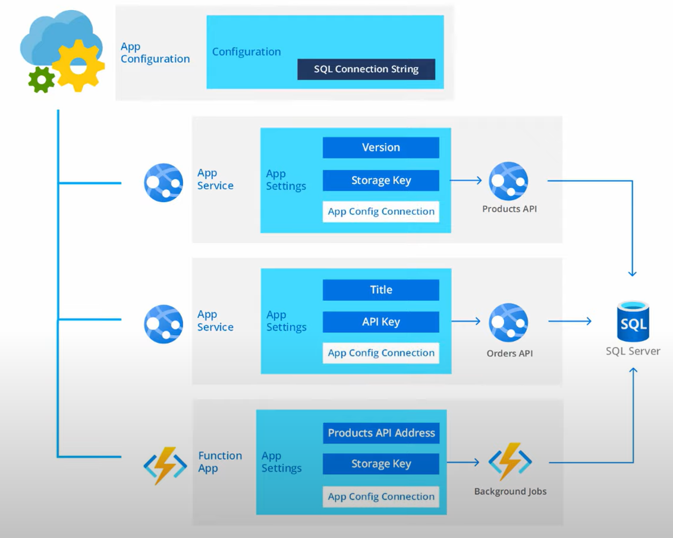
Azure App Configurations
Azure App Configuration is a globally distributed service to store, access and manage application settings in a centralized way.
At its core level it exposes a domain name endpoint which is restful API.

Slide 4
The SDK or Azure CLI abstracts away the calls being made to the restful API.
Azure App Configuration is a complimentary service to Azure Key Vault and not a replacement.
Sensitive data(secrets and certificates) should be stored in Azure Key Vaults and Application-settings can be stored in Azure App Configuration.
We can link Azure key vaults secrets and certificates via a reference in Azure App Configuration.
Azure Configurations provide –
Storing/Retrieval of Application Settings
Feature Management

Slide 5
Security
All data stored with Azure App Configuration are encrypted by default while at rest and transit both.
Encryption can be managed using Microsoft or Customer Managed Keys.
Any incoming/outgoing traffic can be optionally public or protected by a VNet.
The Azure app configuration resource can be protected optionally with a Connection string or Managed Identities.

Slide 6
Pricing and SKU
There are 2 SKU(s) Free and Standard.
Feature | Free | Standard
Resource / Subscription | 1 | Unlimited
Storage per Resource | 10 MB | 1 GB
Revision History (Point in Time) | 7 days | 30 days
Rate limit | 1000 requests / day (Will return HTTP 429 with retry-after-ms header set until the end of the day) | 30000 requests / hour (Will return HTTP 429 with retry-after-ms header set until the end of the hour) First 200,000 requests are free.
SLA | None | 99.9% availability
Cost | Free | $1.2 / day and $36.00 / month. $0.06 / 10000 requests if exceeded included quota of 200,000 requests.

Slide 7
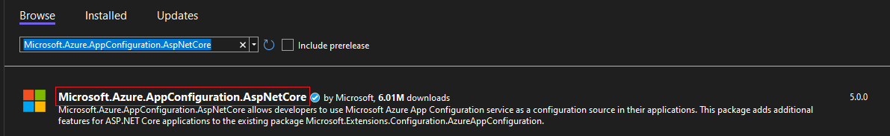
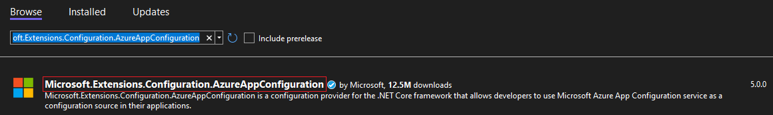
Azure App Configuration C# SDK
ASP .NET Core –
Install-Package Microsoft.Azure.AppConfiguration.AspNetCore -Version 5.0.0
ASP .NET Framework –
Install-Package Microsoft.Extensions.Configuration.AzureAppConfiguration -Version 5.0.0

Slide 8
Keys and Values
Application settings in Azure App Configuration are stored in key-value pairs.
Each application setting can be only be up to 10KB.
Key-values settings are stored in a flat structure in Azure App Configuration.
To store hierarchical application settings, we need to flatten the nested keys using : as the delimiter.
For an appsettings.json setting like this – { "outerMostKey" : { "outerKey" : { "innerKey" : "value" } } } | It can be expressed as – "outerMostKey:outerKey:innerKey" : "value"

Slide 9
ASP .NET Core provides various configuration providers for reading the application settings.
The SDK will scan for key changes and use a poll model to refresh all the keys within a specific window.
The SDK will cache the keys in that specific window and not make an HTTP call. Once the window is complete again the SDK will make a HTTP call to fetch the new keys.
The default window to expire the keys is 30 seconds and is configurable.

Slide 10
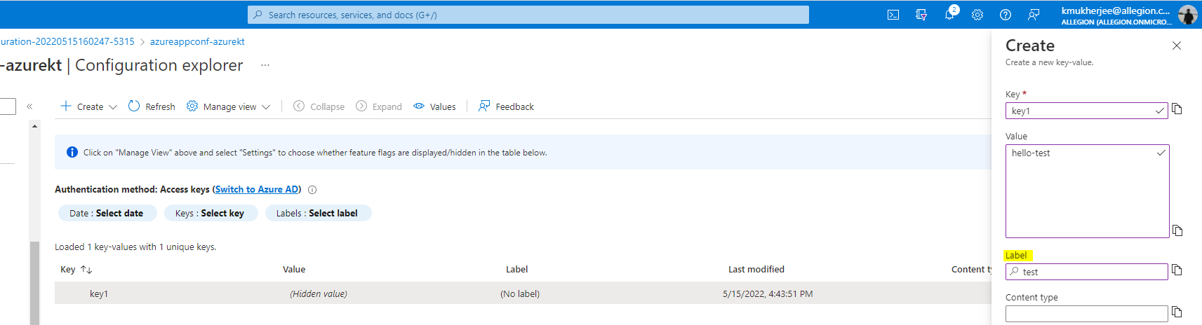
We can attach labels and content-type information to a key-value pair setting.
Labels provide additional metadata and can be considered a variant of the same key.
A single key can be created multiple times using different labels.
Labels can be used to distinguish between environments (Dev, Staging, Production).

Slide 11
Sentinel Key
Sentinel key is a special key to signal Azure App Configuration that some/all the keys have been changed.
Application code will be monitoring the Sentinel Key for changes, this is useful because it reduces the number of HTTP calls to find out keys got changed or not.
To signal that some/all keys have been changed, we simply update the value of the Sentinel key from the Azure portal or the Azure CLI.
If we aren't using a sentinel key, we need to manually register every key we want to monitor.
We use the IOptionSnapShot<T> is ASP .NET Core which automatically loads the configuration when changes in structure happen.

Slide 12
Azure App Configuration ASP .NET Core 6 Demo

Slide 13
Azure App Configuration ASP .NET Web API 2 (.NET Framework) Demo

Slide 14
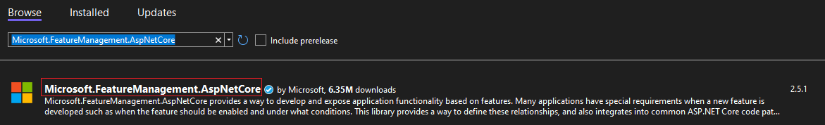
Feature Management
Feature flags are a software development process where we enable/disable a certain functionality of the software without deploying the code.
They can be useful in running A/B testing or manage beta versions.
To get started with Feature Flags install the package –
Install-Package Microsoft.FeatureManagement.AspNetCore -Version 2.5.1

Slide 15
Feature flags can be implemented in the following ways to check if a feature is enabled or not –
Injecting IFeatureManager using DI and checking at the application code level.
Using FeatureGate attribute at the controller/action level.
If we are using IFeatureManager multiple places within the application, it can generate inconsistent values in a HTTP request.
To mitigate this issue, we have a new IFeatureManagerSnapshot interface which provides consistency across a given HTTP request and remembers the state.

Slide 16
Feature Management Demo

